Slide 1

Voice of the UK’s maritime engineering and business sector

Slide 2
SMI - Six Sector Interest Groups
CMG – Commercial Marine Group (Commercial maritime operations including ship building, repair and marine equipment)
MSTG - Marine Science & Technology Group
MASG - Maritime Autonomous Systems Group
MDSG – Maritime Defence & Security Group (Naval and maritime defence)
PTG - Ports and Terminals Group
DTG - Digital Technology Group
Councils of members – 12-20 members per Council

Slide 3
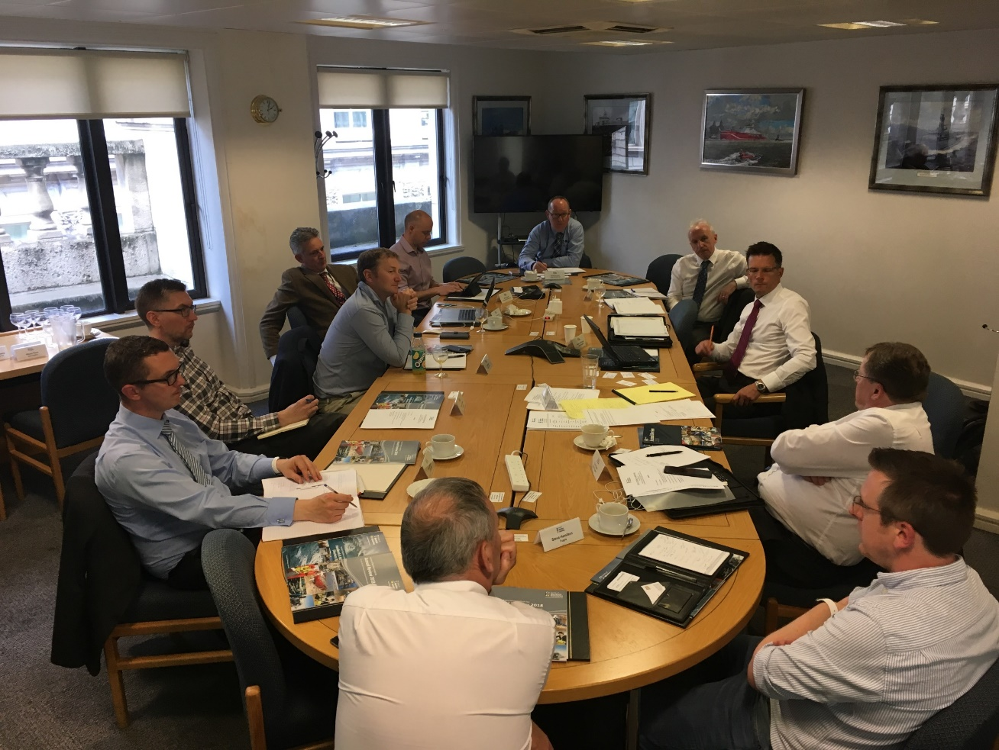
Digital Technology Group
Objectives
Provide a forum to look at new technologies
Government / Maritime 2050
Develop business opportunities

Slide 4
Cyber for Competitive Advantage
Bath UK
21st January 2020

Slide 5


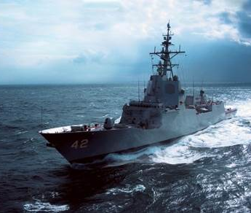

BMT at a glance
47
4
Established
1985
offices
continents
1,500 people
Turnover 2016-17:
Distribution:
£175m
£0.7m
www.bmt.org

Slide 6
Overview
‘Cyber for Competitive Advantage’

Slide 7


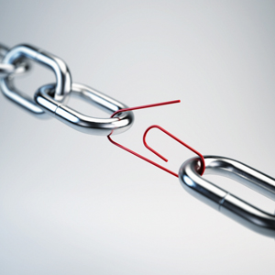

Overview
MSC Resolution 428 (98)
Cyber Risk Management
Supply Chain Best Practice
Cyber for Competitive Advantage

Slide 8
MSC Resolution
MSC.428/98/23/Add.1 (Annex 10, page 1)
Resolution adopted by the Maritime Safety Committee (MSC) on the 16th June 2017
‘Recognizing the urgent need to raise awareness on cyber risk, threats and vulnerabilities to support safe and secure shipping, which is operationally resilient to cyber risks’
MSC.428/98/23/Add.1 (Annex 10, page 1, para2)

Slide 9

‘Affirms that an approved safety management system should take into account cyber risk management in accordance with the objectives and functional requirements of the ISM code.’
‘Encourages Administrations to ensure that cyber risks are appropriately addressed in safety management systems no later than the first annual verification of the company's document of compliance after 1 January 2021.’

Slide 10
IMO Regulation
So what?
Cyber Risk Management?

Slide 11

NCSC Risk Management Guidance V1.0 2018
The purpose of (cyber) risk management is not to chase the unattainable goal of perfectly secure systems and a risk free business; it is to make sure that you have thought about what can go wrong and that this thinking has influenced your organisational decisions
Click here to view

Slide 12
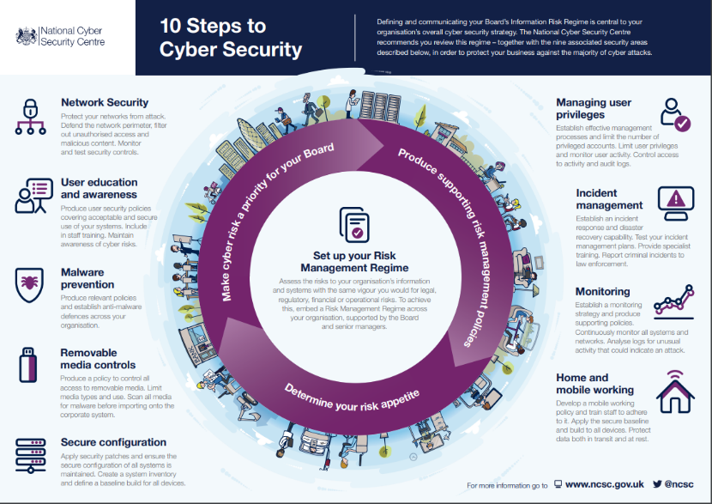

Slide 13
IMO Cyber Risk Management Definition
… the means and process of identifying , analysing and communicating a cyber related risk and accepting , avoiding, transferring or mitigating it to acceptable level by taking it into consideration the costs and benefits of actions taken by stakeholders.
Click here to view

Slide 14
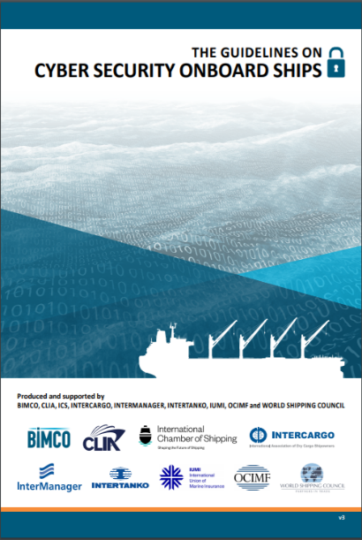
Cyber Risk Management Guidance
IMO guidance
  - MSC-FAL/Circ3
BIMCO et al guidance
  - V3.0, Annex 2
NIST CSF (2014)
  - V1.1 (2018)
ISO 27000 series
NCSC CAF

Slide 15


Orientation
MSC Resolution 428 (98)
Cyber Risk Management
Supply Chain Best Practice
Cyber for Competitive Advantage

Slide 16
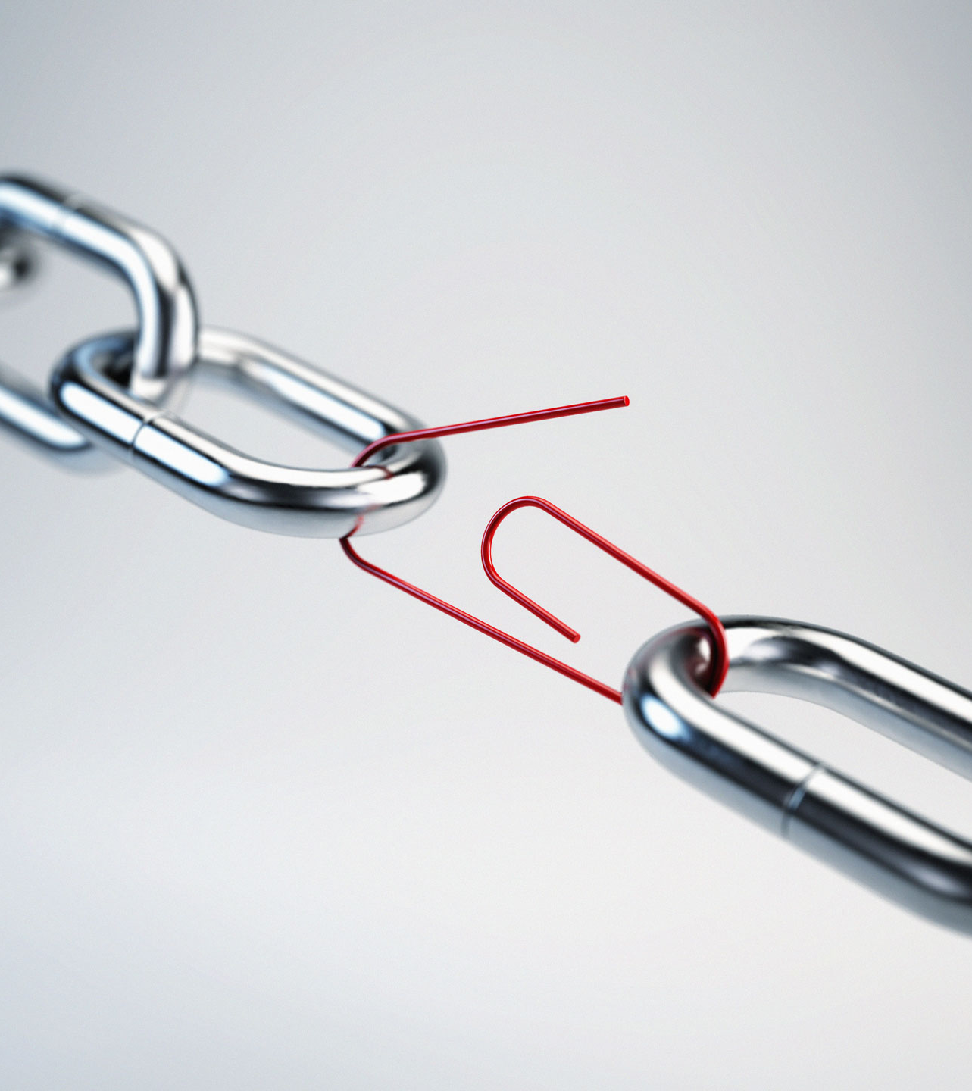
Cyber Risk Management in the Supply Chain
We want to identify anticipated behaviors/expectations from customers
In turn understand the vendor organizational behavior to align with these customer expectations
Represent a positive differentiator and drive competitive advantage

Slide 17
Cyber Risk Management in the Supply Chain
NCSC 12 Principles of Supply Chain security guidance
12 Principles broken down into four separate stages
  Understand the Risk
  Establish Control
  Check your arrangements
  Continuous improvement
Click here to view

Slide 18

Stage 1: Understand the Risks
Know who your suppliers are and build an understanding of what their security looks like
Understand the security risk posed by your supply chain

Slide 19
Stage 2: Establish Control
Communicate your view of security needs to your suppliers
Set and communicate minimum security requirements for your suppliers
Build security considerations into your normal contracting processes and require that your suppliers do the same

Slide 20
Stage 2: Establish Control
Meet your own security responsibilities as a supplier and consumer
Raise awareness of security within your supply chain
Provide support for security incidents

Slide 21
Stage 3: Check your arrangements
Build assurance activities into your supply chain security management

Slide 22
Stage 4: Continuous Improvement
Encourage the continuous improvement of security within your supply chain
Build trust with Suppliers

Slide 23

Vendor Behaviours

Slide 24
Vendor Behaviours
Build your organisational picture of security and be prepared to present it. Think Evidence.
Build and maintain the picture of security in your supply chain
Security requirements in contracts

Slide 25
Vendor Behaviours
Share Information
Incident Response Preparation
A word of caution….

Slide 26

    Every sale has five basic obstacles: no need, no money, no hurry, no desire, no trust.
              Zig Ziglar

Slide 27
    Sales is not about selling anymore, but about building trust and educating
              Siva Devaki

Slide 28

Cyber for Competitive Advantage Takeaway
Proactive activity. You have time.
Build the picture of organizational cyber capability, competence and culture.
Use it…
  Sales pipeline
  Collaboration/Partnerships/Alliances
  Insurance
Digital trust.

Slide 29
Overview
MSC Resolution 428 (98)
Cyber Risk Management
Supply Chain Best Practice
Cyber for Competitive Advantage

Slide 30

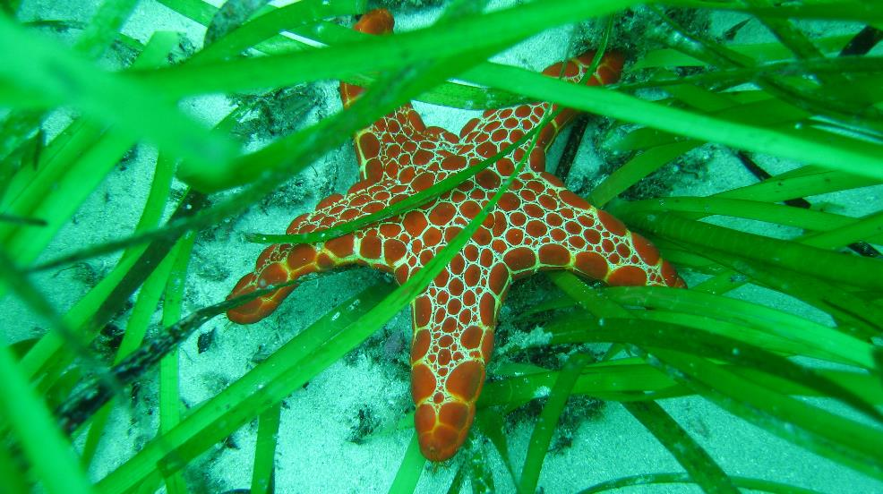
Click here for BMT Cyber Services
Thank you
enquiries@bmtglobal.com
Copyright© by BMT
All rights reserved. No part of this publication may be reproduced,
distributed, or transmitted in any form or by any means, including
photocopying, recording, or other electronic or mechanical methods,
without the prior written permission of BMT.
Where content has not been produced by BMT, we have sought
the appropriate authorisation for its use and does not constitute an
infringement of copyright.

