Slide 1
Precise, safe, quiet and robust
SPARO
Patent GB2116641, US 12,043,383 B2
Two-way air-ground playload transfer in all environments

Slide 2
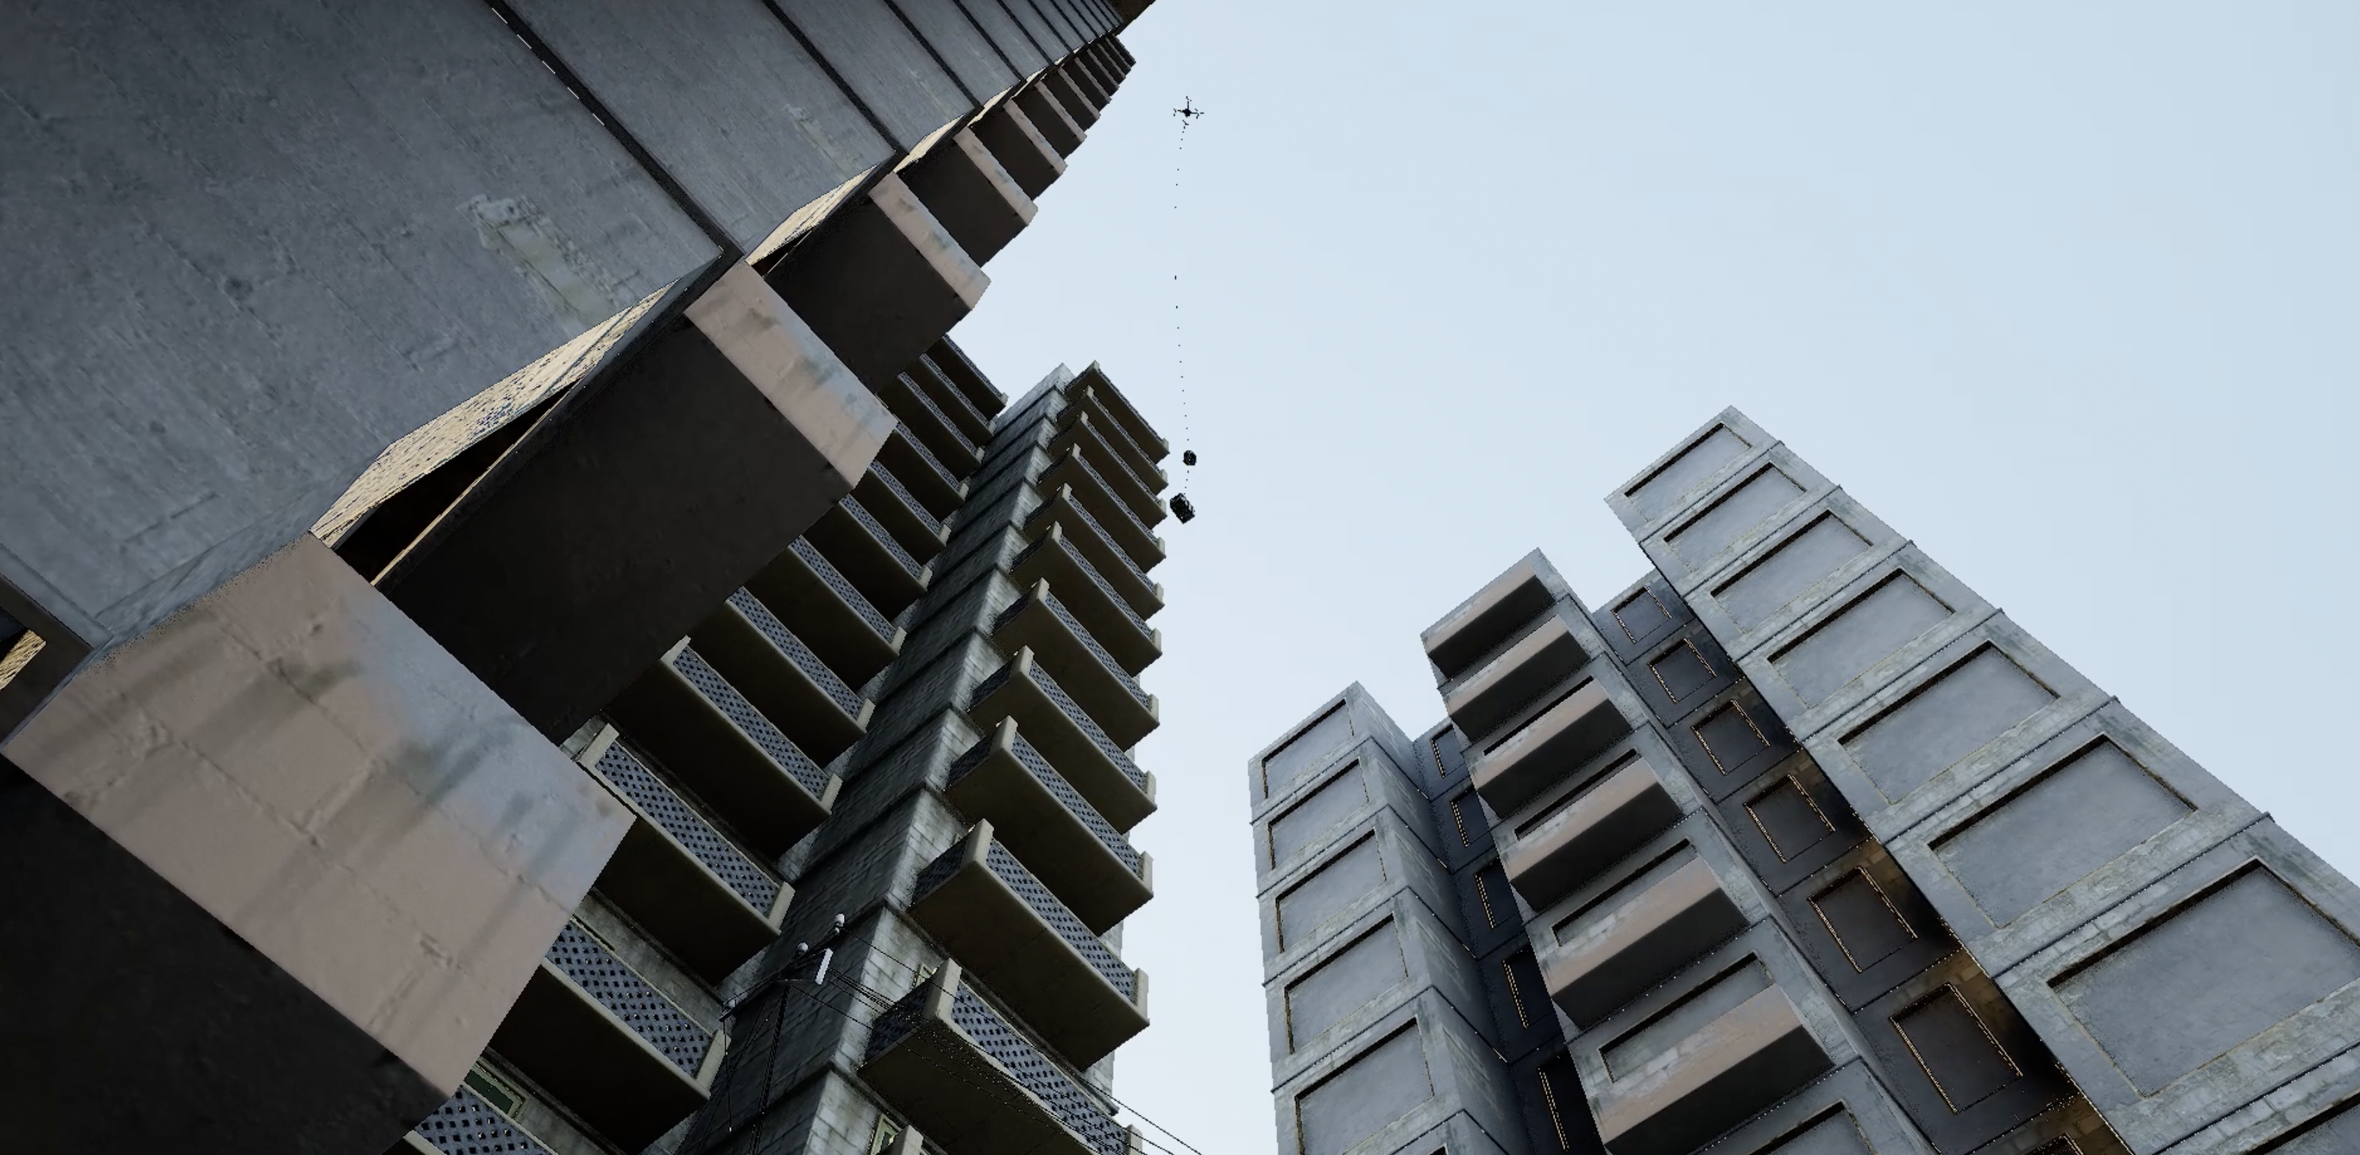
Contents
Problem
BMT SPARO
Components
Variants
Teaser Footage
Key Benefits

Slide 3




Problem
Winch
Location of payload
Location of need
Payload ready to go
NEED
Needed payload
Drones offer huge potential for fast, safe, sustainable, resilient, and low-cost logistics, with benefits across Defence, e-commerce, critical infrastructure, commercial maritime, emergency services, and healthcare markets.
However, the required drones are large, noisy, vulnerable to damage and hazardous to people. This places severe constraints on when and where they can be safely used to collect and deliver payloads.
The problem can be minimised by keeping the drone hovering high enough to reduce noise and remain safely clear above surface infrastructure. However, no system currently exists that allows a drone hovering at height to autonomously collect and precisely deliver a payload on the ground.
The result is that the full potential of drone logistics is not being realised.
Winch
Transport
personnel
Ground transport
Ground transport
Transport
personnel
Flightline
Drone-friendly location
Payloads ready for flight
Drone fleet
Received
payloads
Lateral
Fans
Logistics trained personnel
Air trained personnel
Air trained personnel
Reality
Poor
horizontal
control
Poor
vertical
control
Result: Drone delivery remains unscalable, with payload journeys dependent on dedicated drone-friendly locations and trained labour

Slide 4
BMT SPARO
Location of payload
Location of need
Payload ready to go
NEED
Needed payload
SPARO is a novel category of air vehicle designed specifically to solve this problem.
SPARO remains docked to a parent aircraft during transit, then released from a hover high above a payload or delivery location.
Uniquely, SPARO then lowers itself at the bottom end of a weight-bearing line by unwinding an internal cable drum to increase the distance between itself and the parent aircraft above. Additional lateral fans counter wind effects and provide horizontal control.
Near ground level SPARO can precisely adjust its vertical and horizontal position relative to the surface to collect or release a payload before rewinding the cable drum to climb back to the aircraft above and redock.
SPARO represents the ideal solution for air logistics, improving access while reducing risks, operating costs, environmental impact and delivery time.
Transport
personnel
Ground transport
Ground transport
Transport
personnel
Flightline
Drone-friendly location
Payloads ready for flight
Drone fleet
Received
payloads
SPARO
Logistics trained personnel
Air trained personnel
Air trained personnel
SPARO reduces dependency on clear space and trained labour, and allows autonomous, scalable, point-to-point drone logistics.

Slide 5
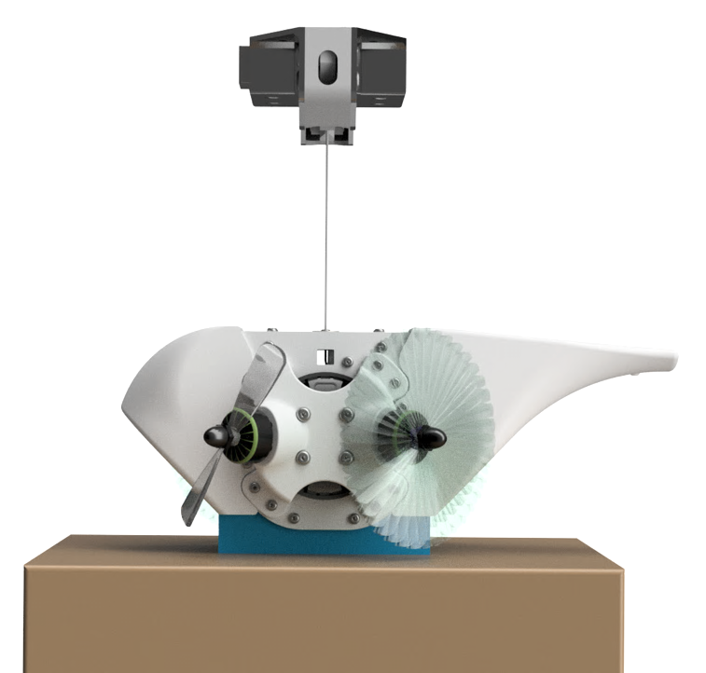
Components
Dock
Aircraft agnostic
Lock/release
Line jettison
Weight-bearing line
Avionics and power
Horizontal and orientation control
12cm
Vertical control
Payload connection mechanism
Payload
System weighs <10% of max payload weight
Scalable for payload weight, drop height and max wind

Slide 6


Capabilities
“… it will provide a capability unlike anything else known to Defence. It would enable the use of UAS to deliver payloads in the most challenging terrain, reducing risk to both the airframe, the payload and personnel on the ground.”
British Army Warfighting Experiment 2023
Independent Product Assessment Report, Royal Artillery Trials and Development Unit
Maritime and industry
E-commerce
Healthcare
Defence logistics and disaster response
Emergency response
Hi!
Hi!

Slide 7
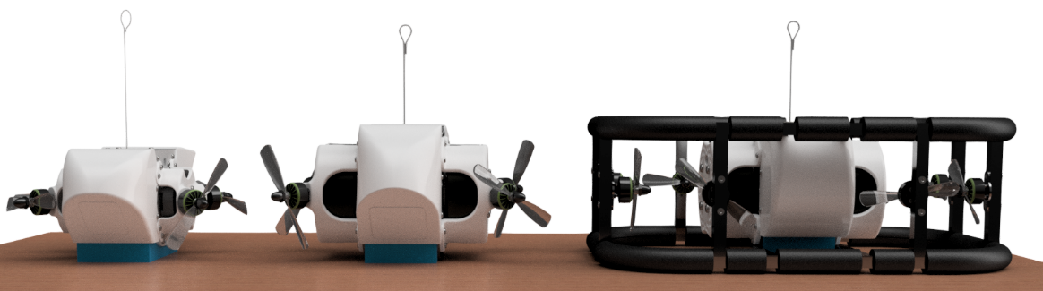
Variants
Lite
1kg SPARO
Up to 10kg payload
300ft drop height
Medium
4kg SPARO
Up to 50kg payload
400ft drop height
Heavy
10kg SPARO
Up to 200kg payload
500ft drop height

Slide 8
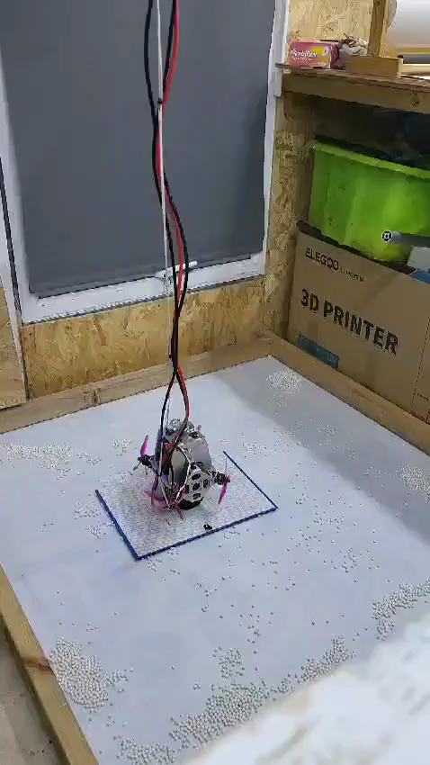
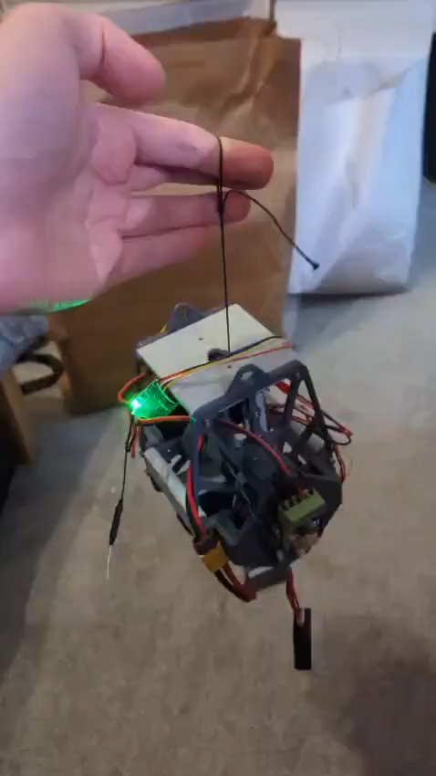
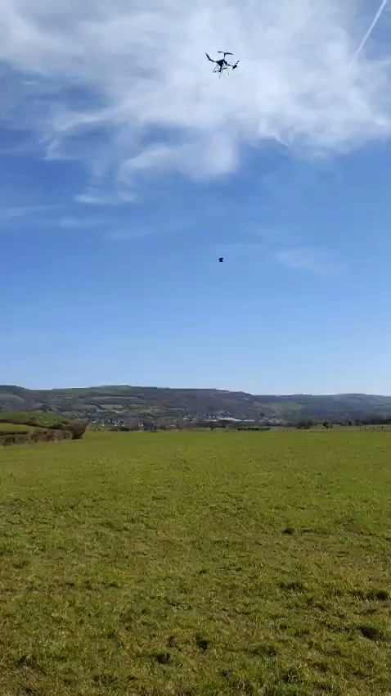
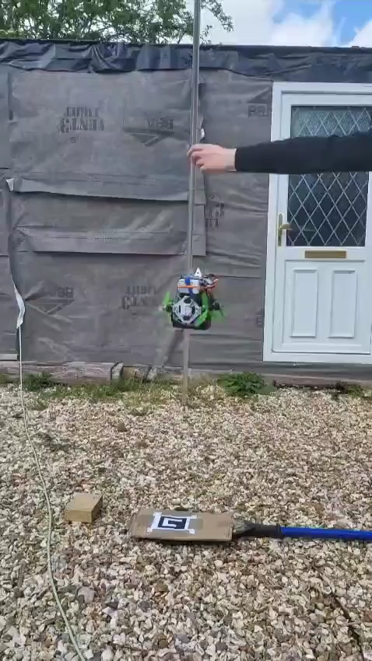
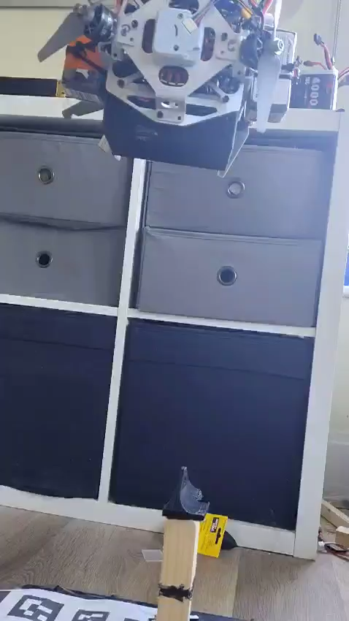
Technical progress – teaser footage
Lateral and orientation
Stabilised ‘hover’
Vertical travel
Computer vision
and guidance
Autonomous connection

Slide 9
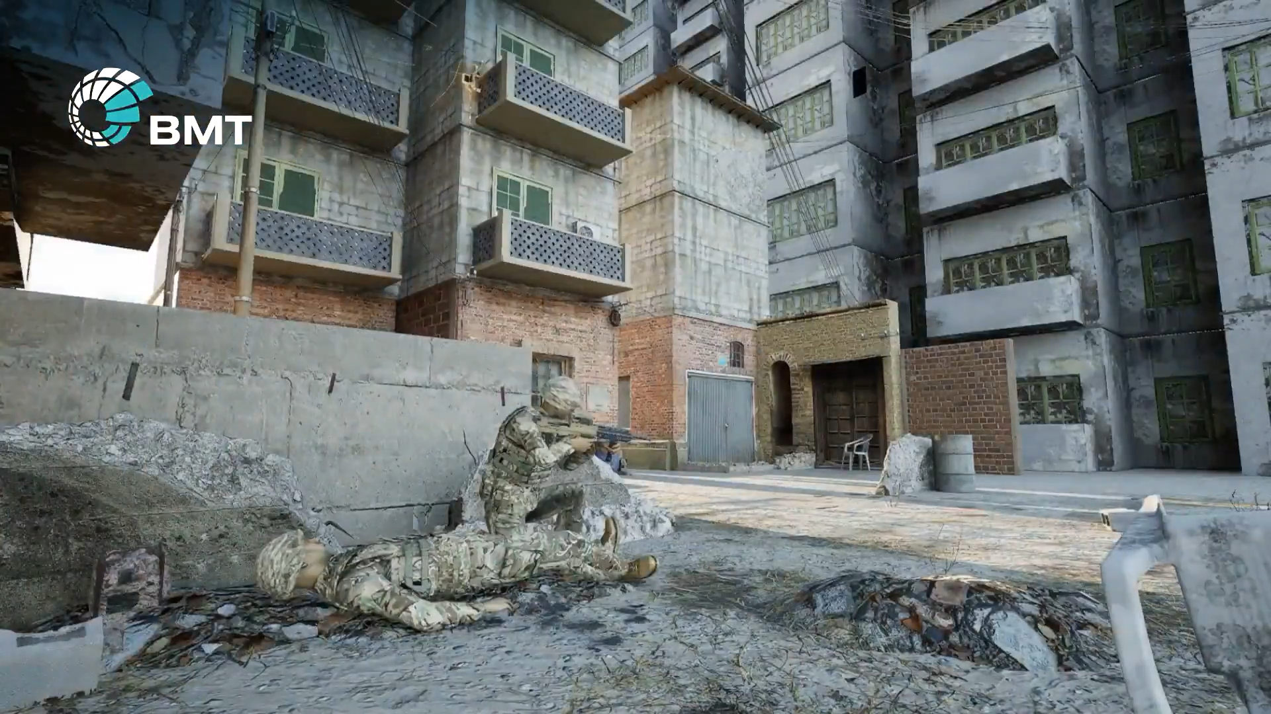

Slide 10
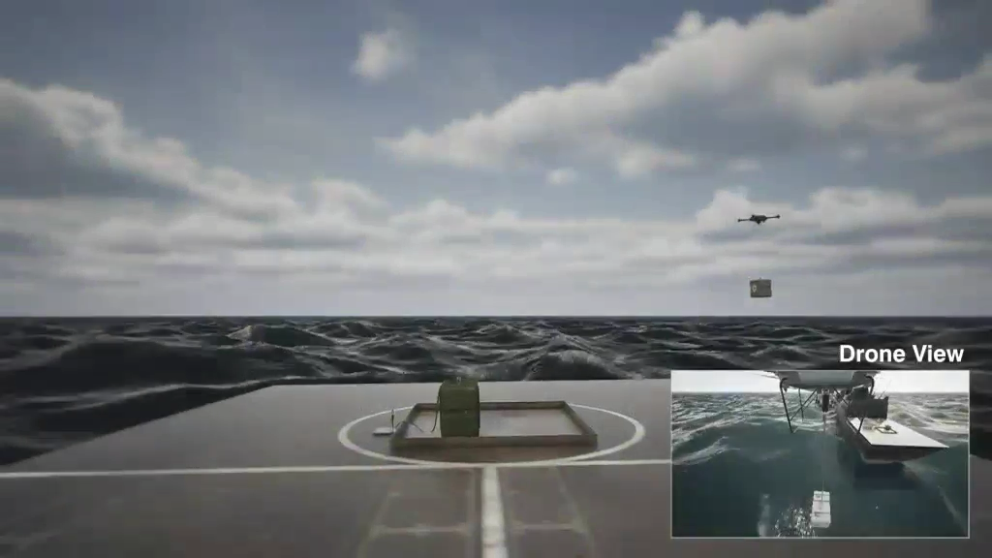

Slide 11
Key benefits
Step-change in Capability
Precise, quiet access to any location from any height
Autonomous operation from collection to delivery
Dock to any aircraft for intelligent logistics capability
Enhanced safety
Reduced risk to the aircraft
Reduced risk to ground infrastructure
Reduced risk for people nearby
Reduced through-life costs
Lower training burden for operators and receivers
Reduced costs to replace/repair damaged aircraft
Open architecture and common commercial components allowing iterative development

Slide 12
Precise, safe, quiet and robust
SPARO
Patent GB2116641, US 12,043,383 B2
Two-way air-ground playload transfer in all environments
For more information contact:
James Campbell – SPARO Lead
james.campbell@uk.bmt.org

